Slide 1
Multiplying & Dividing Rational Expressions

Slide 2
Rational Expression
The quotient of two polynomials

Slide 3
Simplest Form
When the numerator and denominator have no common factors
=

Slide 4
True or false?

Slide 5
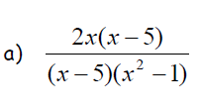

Slide 7
c.

Slide 8
Video

Slide 10
You try

Slide 11
You try

Slide 12
Dividing rational functions
When dividing rational functions, you multiply the first fraction by the reciprocal of the second fraction, and simplifying (i.e. canceling, like we did with multiplication) where you can. We call this:
KEEP – CHANGE - FLIP

Slide 13
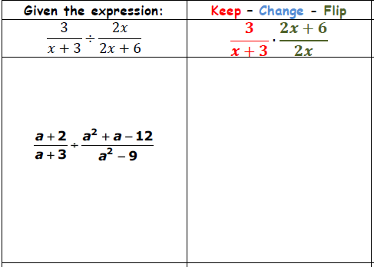

Slide 14
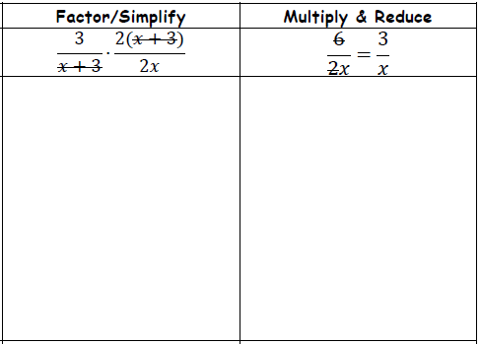

Slide 16
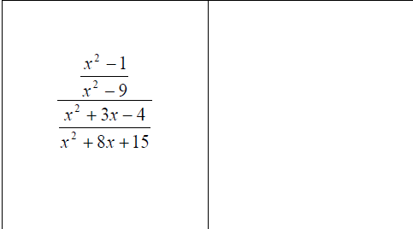

Slide 17
