Slide 1
The Unit Circle
Objective: memorize the Unit Circle, convert from radians to degrees and vice versa
What is the Unit Circle and how is it used?

Slide 2
Periodic Functions
A periodic function is a function that repeats a pattern of Y-VALUES (or outputs) at regular intervals.
One complete pattern is a CYCLE. A cycle may begin at any point on the graph of a function.
The time it takes for a cycle to repeat is called the PERIOD

Slide 3
Amplitude
The amplitude of a periodic function measures the amount of VARIATION (up and down) in the function values.
The amplitude can be found using the formula:

Slide 4
Example

Slide 6
Radians vs. Degrees
A degree is the amount of rotation around a circle (used in geometry and real-world applications)
A radian is the measure of the arc.
(Think: circumference = )
You can switch between using degrees and radians.

Slide 7
Degrees → Radians
Divide by 180 (multiply by )
Radians → Degrees
Multiply by 180 (divide by )

Slide 8
Note: Radians must always be in “pi” form. Degrees must always be in “decimal” form
Convert from… | To… | Formula | Answer
90° | Radians
radians | Degrees
200° | Radians
radians | Degrees

Slide 10
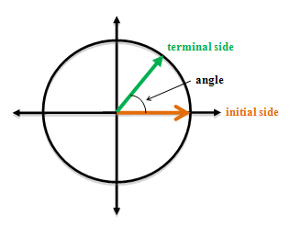
A full rotation around a circle totals 360° degrees, which is the same as 2∏ radians.

Slide 11
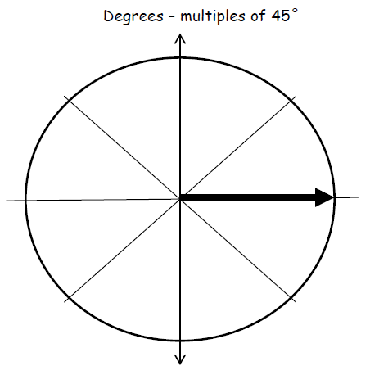

Slide 12
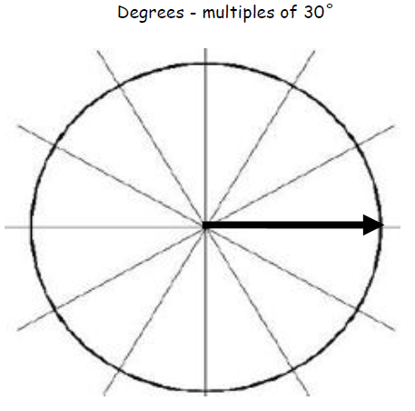

Slide 13
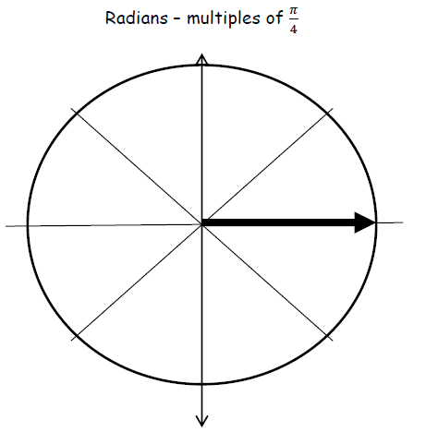

Slide 14
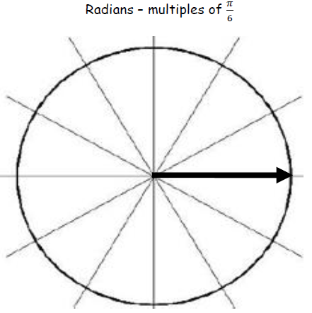

Slide 15
30°

Slide 17
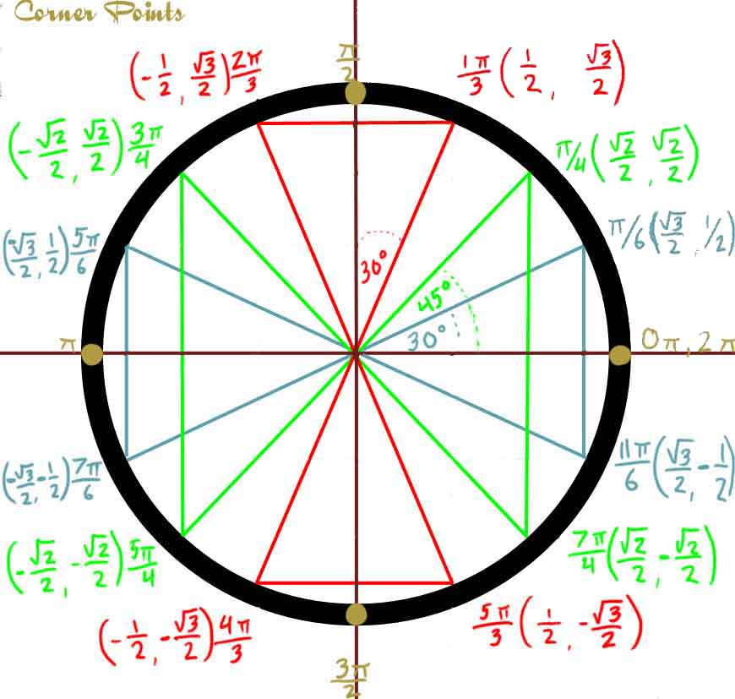

Slide 18
The symbol used for an unknown angle is called THETA it looks like this: Ѳ
Instead of creating a RIGHT TRIANGLE and doing “SOHCAHTOA” to find the sine, cosine or tangent, you can use the unit circle to look up the values quickly. Just remember that
cos(Ѳ) = X and sine(Ѳ) = Y

Slide 19
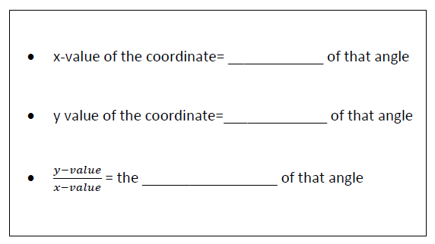

Slide 20
Positive Angles:
Negative:

Slide 21
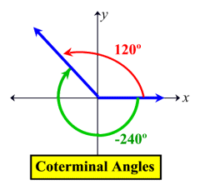

Slide 22
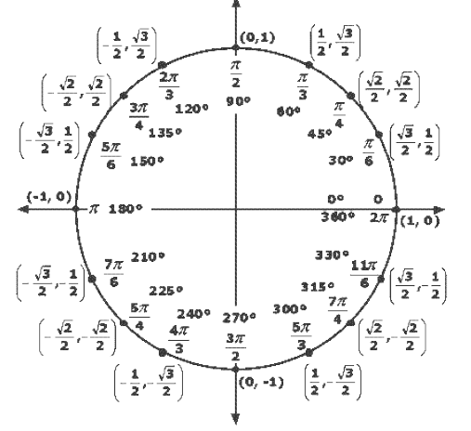
Evaluate using your Unit Circle
cos(45°)
sin(120°)
cos(180°)

Slide 23
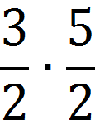
Finding tangent
Divide the coordinates (y on top)
Dividing fractions: “Keep, Change, Flip”

Slide 24
tan(315°)

Slide 27
