Slide 1
Graphs of Trigonometric Functions

Slide 2
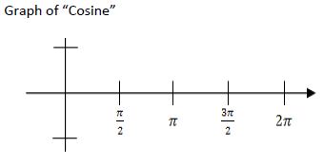

Slide 3
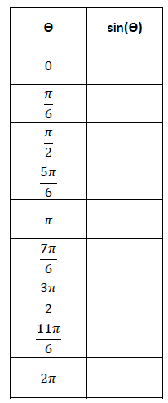
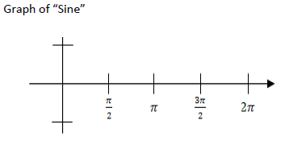

Slide 4
Graphing in the calculator
1. Calculator needs to be in radian mode
2. Use “x” for
3. Zoom Trig (#7)

Slide 5
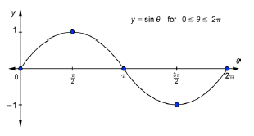
Transformations of Sine & cosine

Slide 6
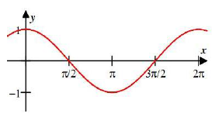

Slide 7
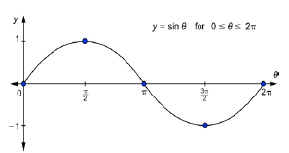

Slide 8
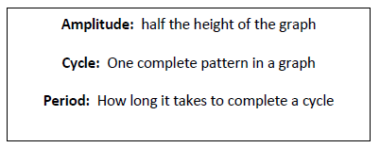

Slide 9
______ is the amplitude of the function
______ is the number of cycles in the interval from ____________
__________ is the period of the function.

Slide 10
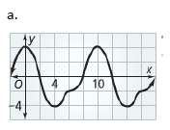

Slide 14
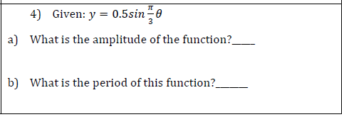

Slide 16
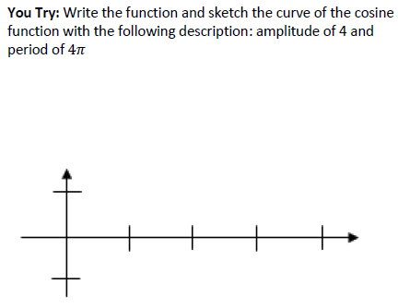

Slide 19
Ferris wheel problem
The position of a person at time “t” on a Ferris Wheel with a center axel 40 meters above the ground can be modeled by the equation
Where “a” is the amplitude
The Ferris Wheel has a diameter of 60 meters and makes a complete rotation every 4 minutes.
Sketch a picture & label dimensions

Slide 20
#1 Find the amplitude
Minimum height of a rider: _____________
Maximum height of a rider: ____________
Amplitude: __________

Slide 21
#2 What is the period of the function?
#3. Use the formula to find b.

Slide 22
#4 Write the equation that models the height of the person at time “t” on this Ferris Wheel:
#5 Use the equation to determine the height of the person when they get on to the Ferris Wheel (t = 0)

Slide 23
Time (minutes) | Height (meters)
0
1
2
3
4
5
6
7
8

