Slide 1
Holes & asymptotes
EQ: How does dividing by zero affect the graph of a function?

Slide 2
Think about it…
A group of people rent a bus for a day. The
total cost of the bus is shared equally among
the passengers.
x = the number of passengers.
y = the cost for each passenger in dollars.

Slide 3
Rational Functions
The quotient of two polynomials

Slide 4
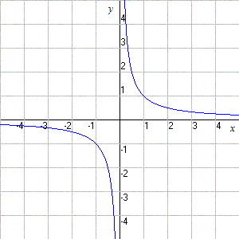
Review: Parent Function

Slide 5
Describe the transformations
1.
2.
3.

Slide 6
Graphing in the calculator
When entering a rational function into the calculator be sure to put parentheses around the entire numerator and entire denominator
f(x) =

Slide 7
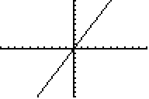
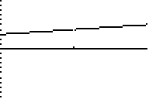
Graph:
Window → “Xmin = 1.5” “Xmax = 2.5”

Slide 8
Points of discontinuity (breaks in the graph) occur at values where the DENOMINATOR = 0
Example:
x cannot equal -1 because…
x + 1 = (-1) + 1 = 0

Slide 9
HOLES
X-values where the denominator = 0 and the factors cancel out
Ex.)

Slide 10
Vertical Asymptotes
X-values where the denominator = zero
and the factors do not cancel out.
Ex 1)

Slide 11
Finding holes & asymptotes
Method 1: Factor, set denominator equal to zero and solve.
Method 2: Use the table to find the “error”.
Method 3: Identify transformations

Slide 12
Method 1: Factor, Solve

Slide 13
Method 2: table

Slide 14
Method 3: transformations

Slide 15
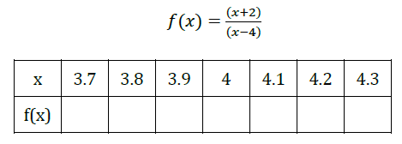
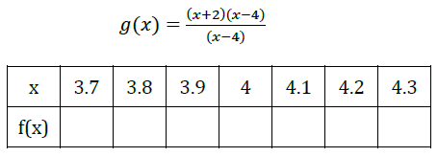

Slide 16
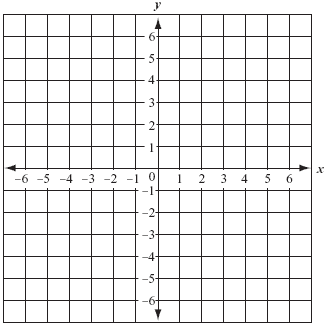
1.
Hole(s):
Asymptotes:
Domain:

Slide 17
2.
Hole(s):
Asymptotes:
Domain:

Slide 18
3.
Hole(s):
Asymptotes:
Domain:

Slide 19
4.
Hole(s):
Asymptotes:
Domain:

Slide 20
5.
Hole(s):
Asymptotes:
Domain:

Slide 21
6.
Hole(s):
Asymptotes:
Domain:

Slide 22
7.
Hole(s):
Asymptotes:
Domain:

Slide 23
Write a rational function that has..
A point of discontinuity (hole) at x=3 and a vertical asymptote at x=-2

Slide 24
Write a rational function that has..
A point of discontinuity at and a vertical asymptote at x=-6

Slide 25
Write a rational function that has..
A point of discontinuity at x=- 1 and x=4 and a vertical asymptote at x=2

Slide 26
Write a rational function that has..
A point of discontinuity at x=8 and a vertical asymptote at x=-2 and x=3

Slide 27
Write a rational function that has..
No points of discontinuity and a vertical asymptote at x=4 and x=-5

Slide 28
Exit ticket
Make up a function that has both a hole & an asymptote. Identify their locations.

