Slide 1
Solving Rational Equations
EQ: How are the rules for simplifying rational expressions used to solve for an unknown variable in a rational equation?

Slide 2
The Multiplicative Identity
Anything times one equals itself

Slide 3
Any value divided by itself equals ONE

Slide 4
Therefore, multiplying a term by the same value on the top and the bottom is the same as multiplying by ONE, which means that the value actually stays the same!
This means that we can follow the same rules as we did for ADDING & SUBTRACTING rational expressions when we solve equations because we are not actually changing the value of the equation!

Slide 5
How to Solve Rational Equations
1. Re-write whole numbers as a fraction)
2. Get LIKE denominators
3. Combined & Simplify NUMERATORS
4. IGNORE the denominators
5. Solve & Check

Slide 6
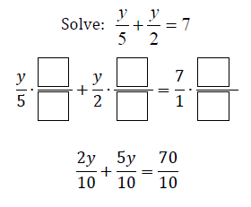

Slide 8
How to Solve Rational Equations
1. Re-write whole numbers as a fraction
2. CROSS MULTIPLY
3. Set products EQUAL to each other
4. Solve & Check

Slide 9
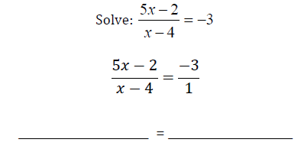

Slide 10
Why do we have to check our solutions?
Extraneous solution: sometimes our answer will occur at a HOLE or ASYMPTOTE. In this situation we say the solution is extraneous. Use your calculator check for locations of holes & asymptotes.

Slide 11
Ex)

Slide 12
1.

Slide 13
2.

Slide 20
Practice Quiz:
1. Name the parent function and the transformations:
2. Determine the domain & range
3. Determine where any holes/asymptotes are:
Solve for x:

